Slide 1
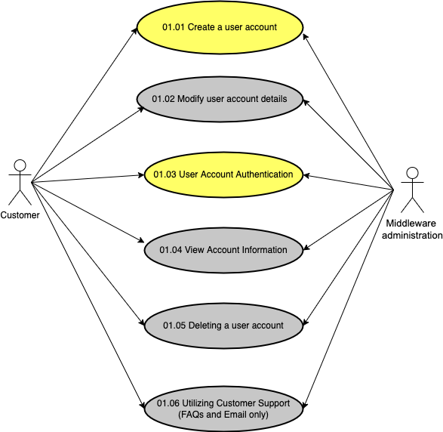
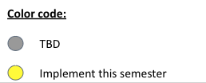
Flaunt Website
Module 01: Account Management
Use Case Diagram

Slide 2
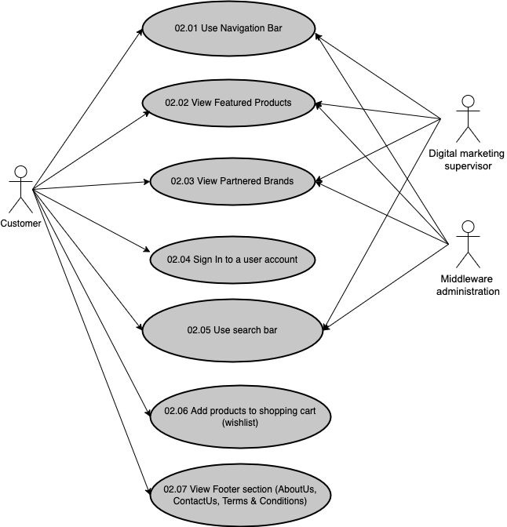
Flaunt Website
Module 02: Browse Product(s)
Use Case Diagram

Slide 3
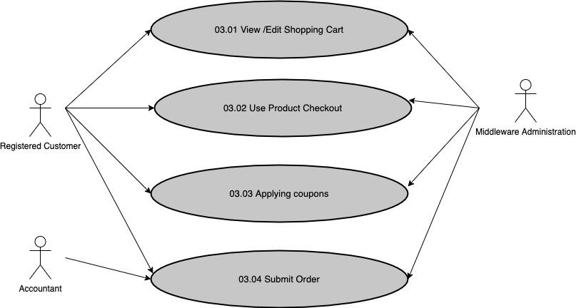
Flaunt Website
Module 03: Purchase Management
Use Case Diagram

Slide 4
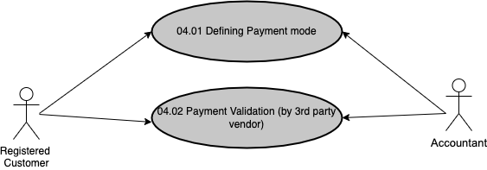
Flaunt Website
Module 04: Payment Gateway
Use Case Diagram

Slide 5
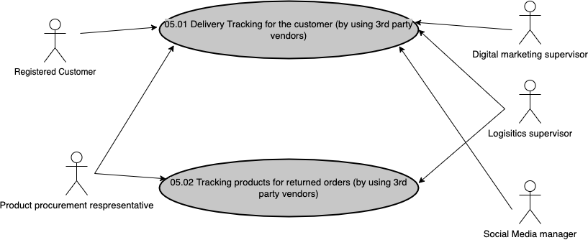
Flaunt Website
Module 05: Logistics Service Provider
Use Case Diagram

Slide 6
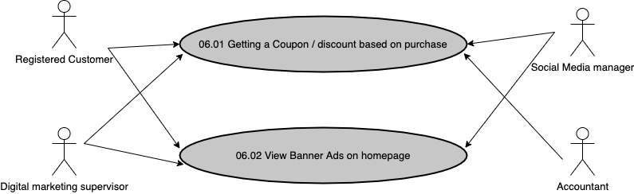
Flaunt Website
Module 06: Advertising Media
Use Case Diagram

